Slide 1
Data Science Unit 2
Inferences Based on a Single Sample: Estimation with Confidence Intervals Chapter 6

Slide 2
Learning Objectives
1. State What Is Estimated
2. Distinguish Point & Interval Estimates
3. Explain Interval Estimates
4. Compute Confidence Interval Estimates for Population Mean & Proportion
5. Compute Sample Size
Notes:
As a result of this class, you will be able to ...

Slide 3
Thinking Challenge
Suppose you’re interested in the average amount of money that students in this class (the population) have on them. How would you find out?

Slide 4
Introduction to Estimation
Notes:
4
9

Slide 5
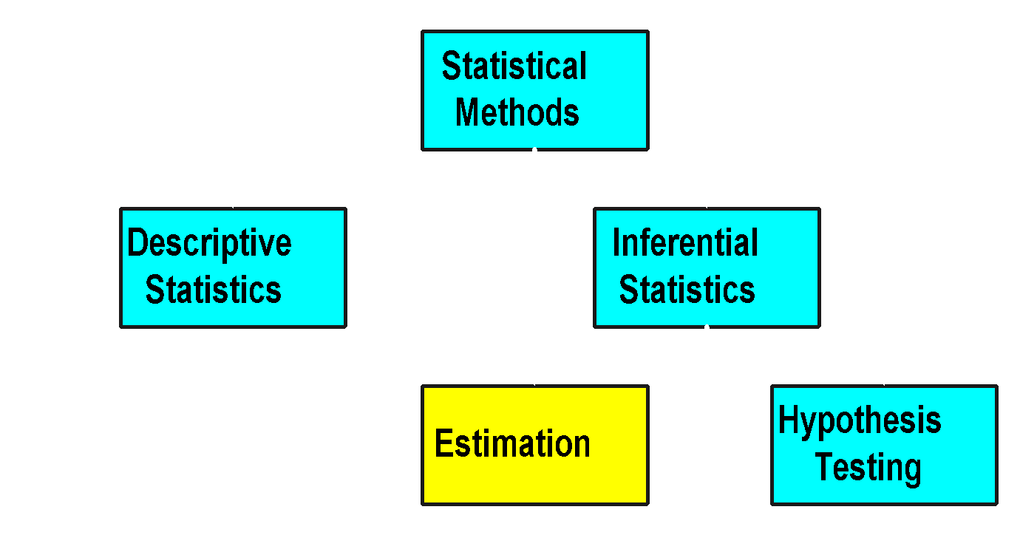
Statistical Methods
Notes:
5

Slide 6
Estimation Process
Notes:
6

Slide 7
Estimation Process
Population
Mean, μ, is unknown
☺
☺
☺
☺
☺
☺
☺
☺
☺
Notes:
7

Slide 8
Estimation Process
Population
Random Sample
Mean X = 50
Mean, μ, is unknown
☺
☺
☺
☺
☺
☺
☺
Sample
☺
☺
☺
☺
Notes:
8

Slide 9

Estimation Process
Population
Random Sample
I am 95% confident that μ is between 40 & 60.
Mean X = 50
Mean, μ, is unknown
☺
☺
☺
☺
☺
☺
☺
Sample
☺
☺
☺
☺
Notes:
9

Slide 10
Unknown Population Parameters Are Estimated
Estimate Population
with Sample
Parameter...
Statistic
Mean
μ

x
Proportion
p
^
p
Variance
σ
2
s
2
Differences
μ
- μ

x
-

x
1
2
1
2

Slide 11
Estimation Methods
Notes:
14

Slide 12
Estimation Methods
Estimation
Notes:
14

Slide 13
Estimation Methods
Estimation
Point
Estimation
Notes:
14

Slide 14
Estimation Methods
Estimation
Point
Interval
Estimation
Estimation
Notes:
14

Slide 15
Point Estimation
Notes:
17
9

Slide 16
Estimation Methods
Estimation
Point
Interval
Estimation
Estimation
Notes:
14

Slide 17
Point Estimation
1. Provides Single Value
Based on Observations from 1 Sample
2. Gives No Information about How Close Value Is to the Unknown Population Parameter
Example:
Sample MeanX = 3 Is Point Estimate of Unknown Population Mean
Average height of VITians is 175 cm

Slide 18
Interval Estimation
Notes:
20
9

Slide 19
Estimation Methods
Estimation
Point
Interval
Estimation
Estimation
Notes:
14

Slide 20
Interval Estimation
1. Provides Range of Values
Based on Observations from 1 Sample
2. Gives Information about Closeness to Unknown Population Parameter
Stated in terms of Probability
Knowing Exact Closeness Requires Knowing Unknown Population Parameter
Example:
Unknown Population Mean Lies Between 50 & 70 with 95% Confidence
Average height of VITians Lies Between 165 & 175 cm with 95% Confidence

Slide 21
Key Elements of Interval Estimation
Notes:
23

Slide 22
Key Elements of Interval Estimation
Sample statistic (point estimate)
Notes:
24

Slide 23
Key Elements of Interval Estimation
Sample statistic (point estimate)
Confidence interval
(interval estimate)
Confidence limit (lower)
Confidence limit (upper)
Notes:
25

Slide 24
Key Elements of Interval Estimation
A probability that the population parameter falls somewhere within the interval.
Sample statistic (point estimate)
Confidence interval
(interval estimate)
Confidence limit (lower)
Confidence limit (upper)
Notes:
26

Slide 25
Confidence Interval
Using only a sample statistic (point estimate) for estimation of parameter is unreliable.
If we report a point estimate, we most probably wont hit the exact population parameter,
But if we report a range of plausible values, we have a good shot at capturing the parameter
Confidence Interval is defined as a plausible range of values for the population parameter
Confidence interval
Sample statistic (point estimate)
Confidence limit (lower)
Confidence limit (upper)
Notes:
Sample mean X is our best guess for the unknown population mean. Hence any interval we construct is to be around that X that we know, to be our best guess. From CLT we know X is distributed nearly normally and the center of the distribution is at the unknown population mean

Slide 26
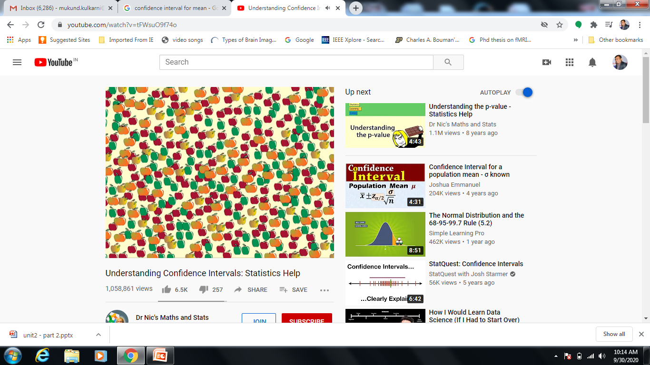
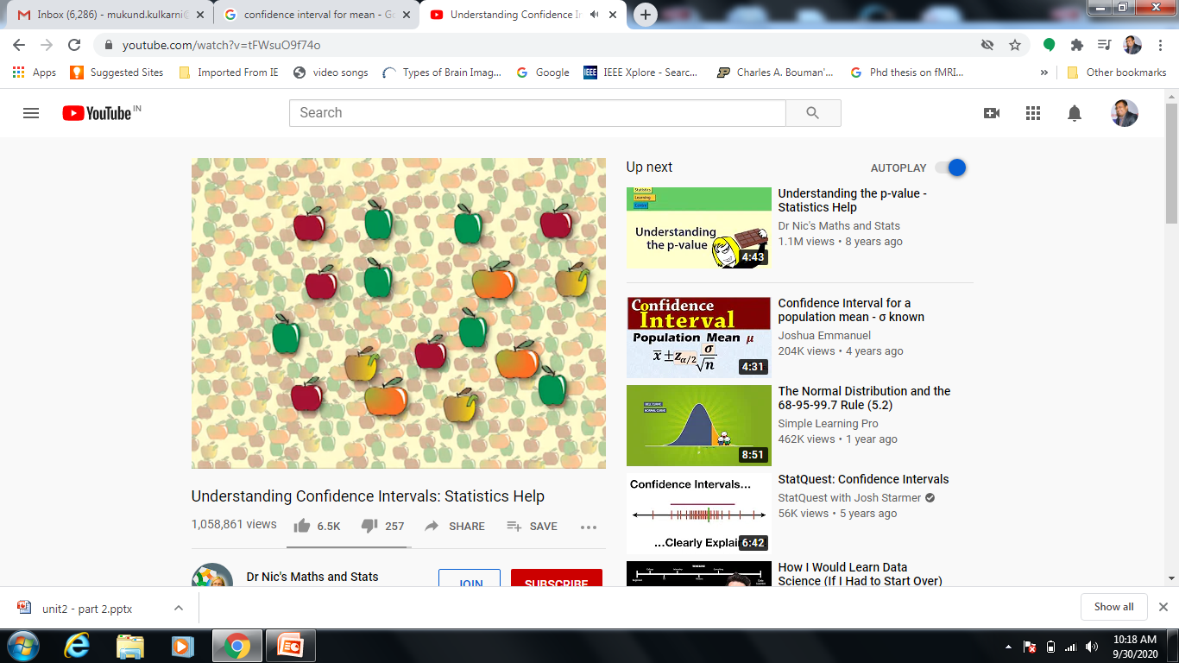
Confidence Interval - Example
Population:
All apples in
orchard
We wish to know how big the apples are?
We can not measure all of them!
So, we take sample of some of them and measure
Sample:

Slide 27
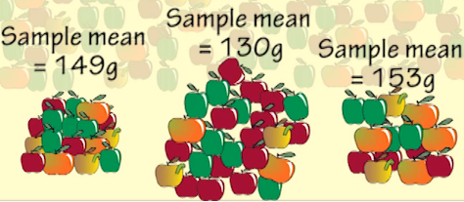
Confidence Interval - Example
Different samples will give different mean 🡪
This is called Sampling Error or variation Due to Sampling!
When we express an estimate of population parameter
It is good practice to give it as a confidence interval
Investigative question:
What is the mean weight of all the apples in the orchard?

Slide 28
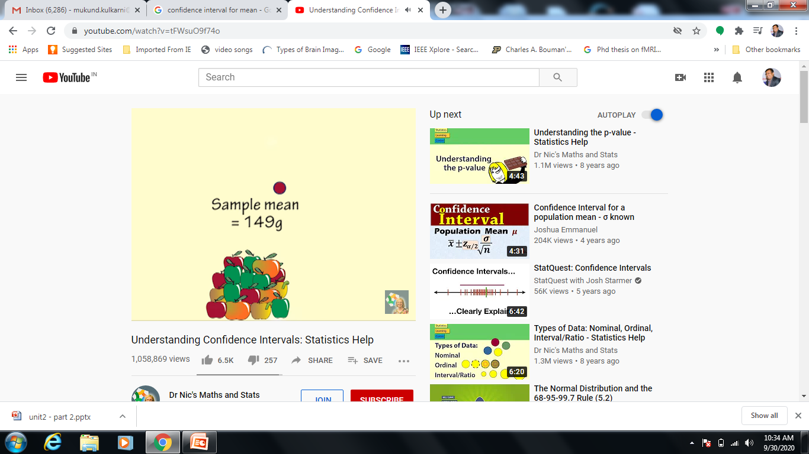
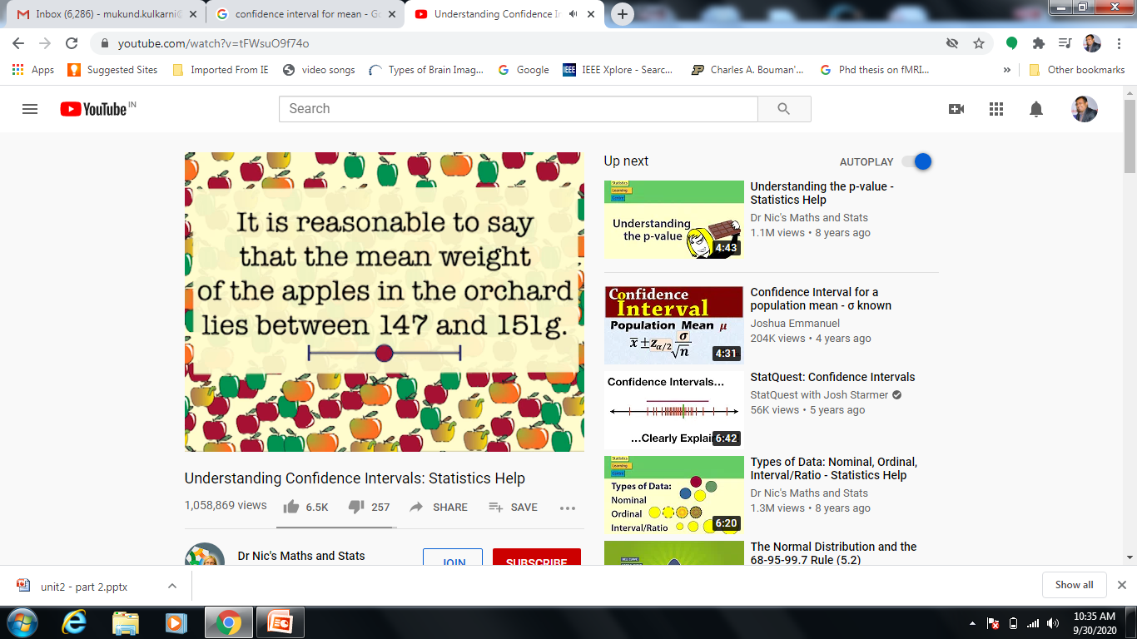
Confidence Interval - Example
Investigative Question:
What is the mean weight of all the apples in the orchard?
Solution:
We take a sample & measure sample mean:

Slide 29
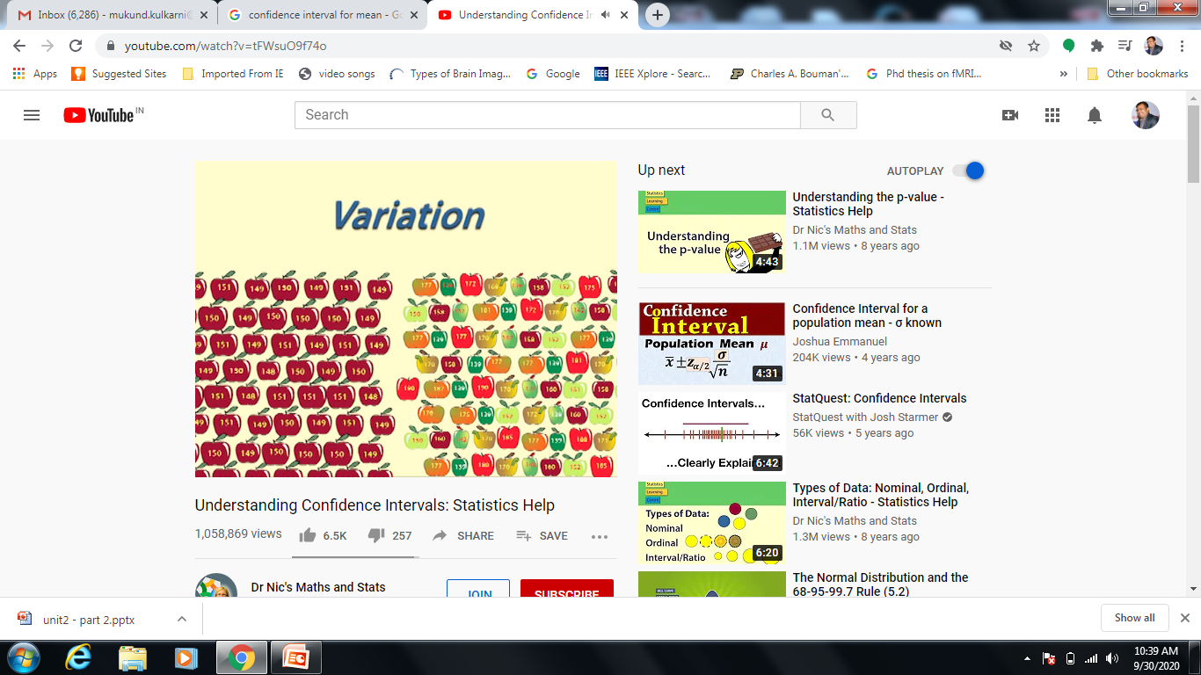
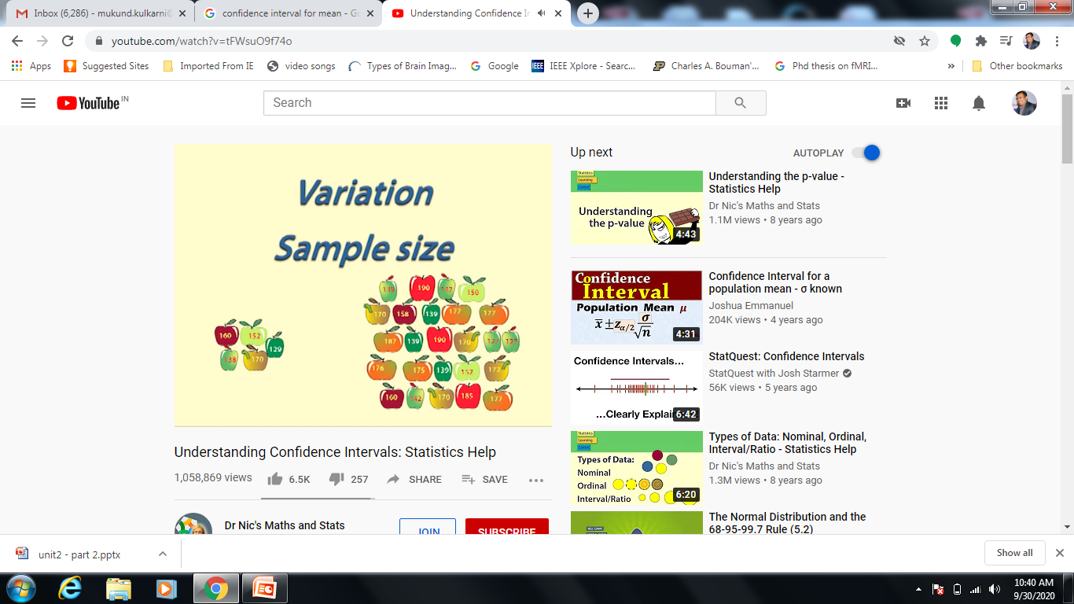
Factors Affecting Width of Confidence Interval
1. Variation within Population
2. Sample Size
We don’t know the variation in population.
But variation in the sample can be indication of variation in population

Slide 30
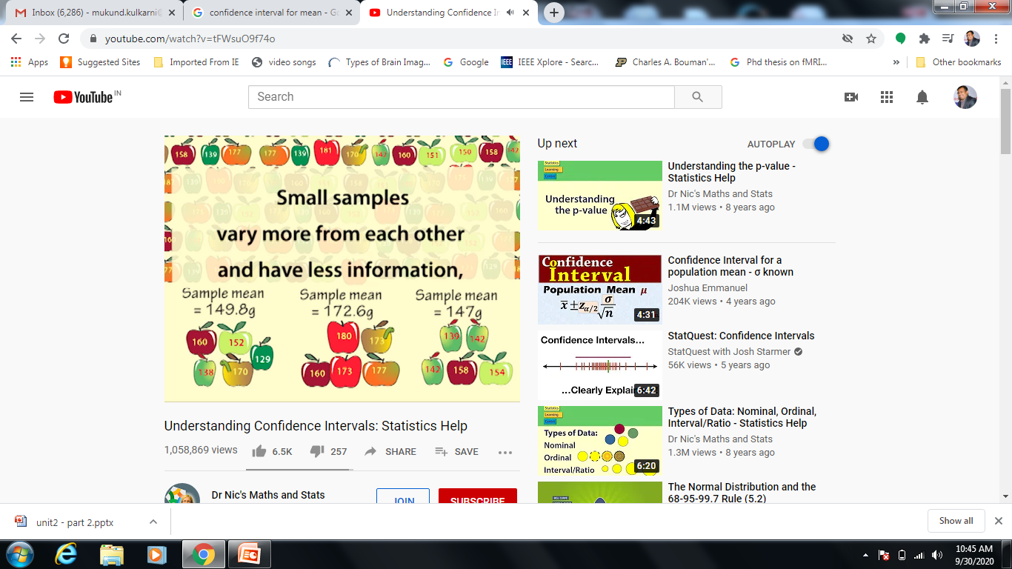
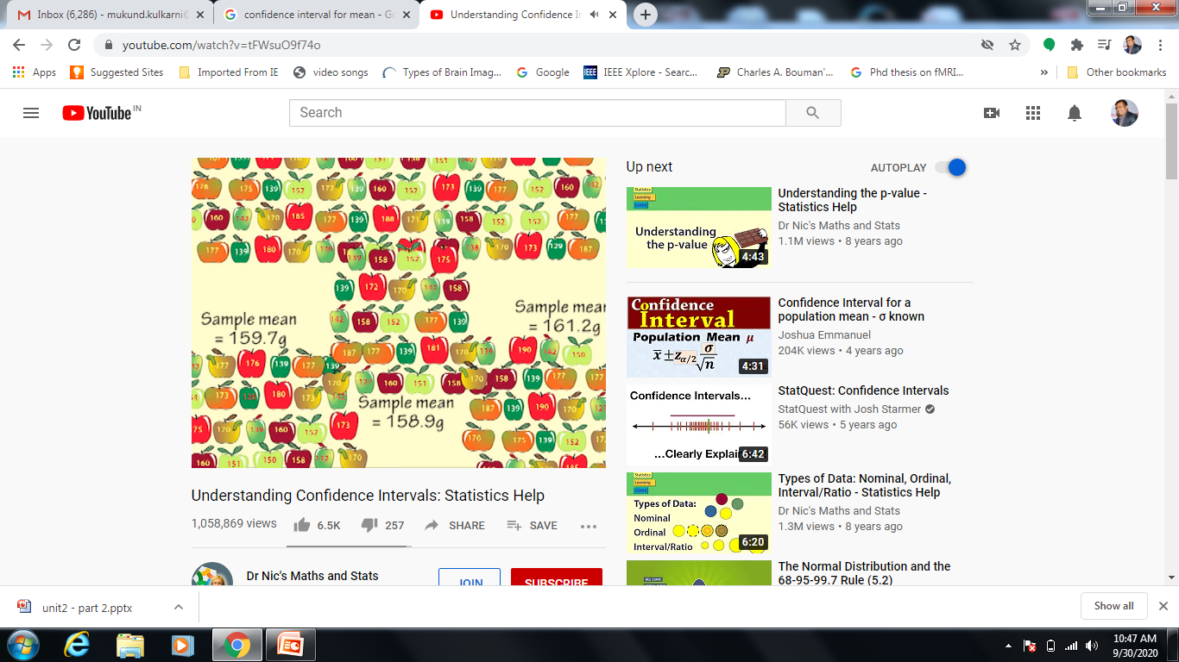
Factors Affecting Width of Confidence Interval
Sample Size
Small sample Size :
Wider confidence interval
Larger sample Size :
Narrow confidence interval

Slide 31
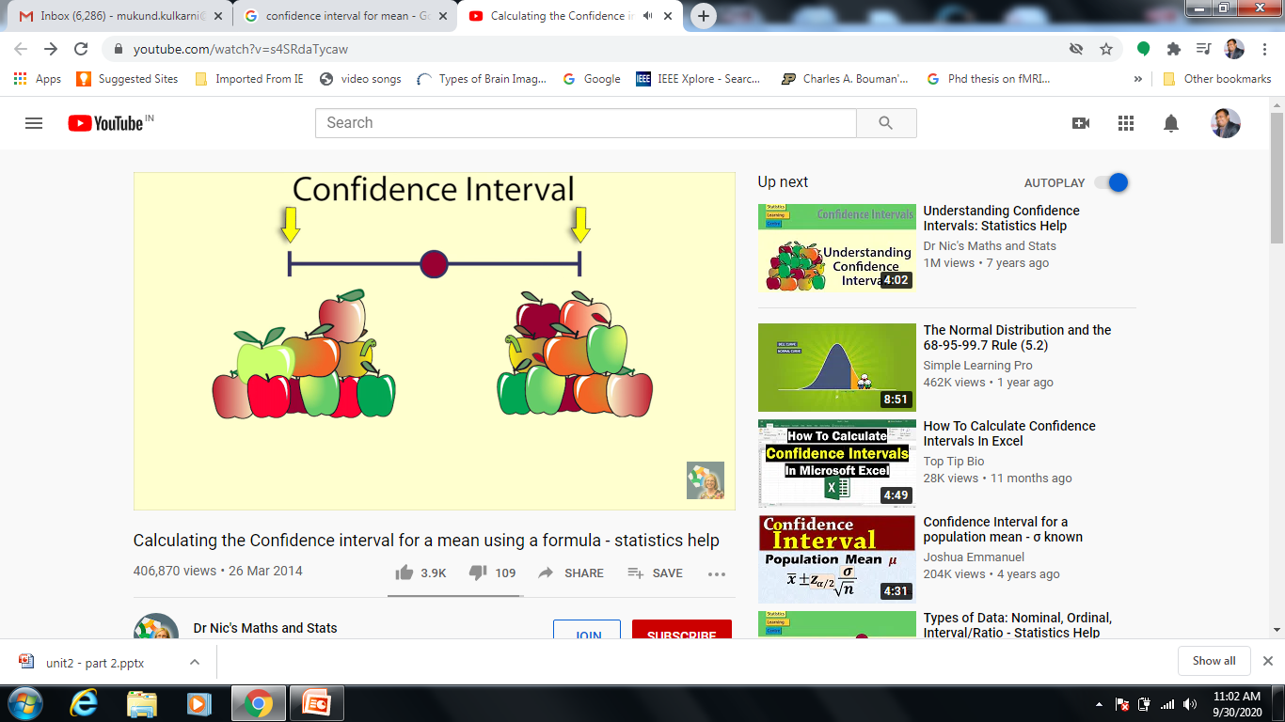
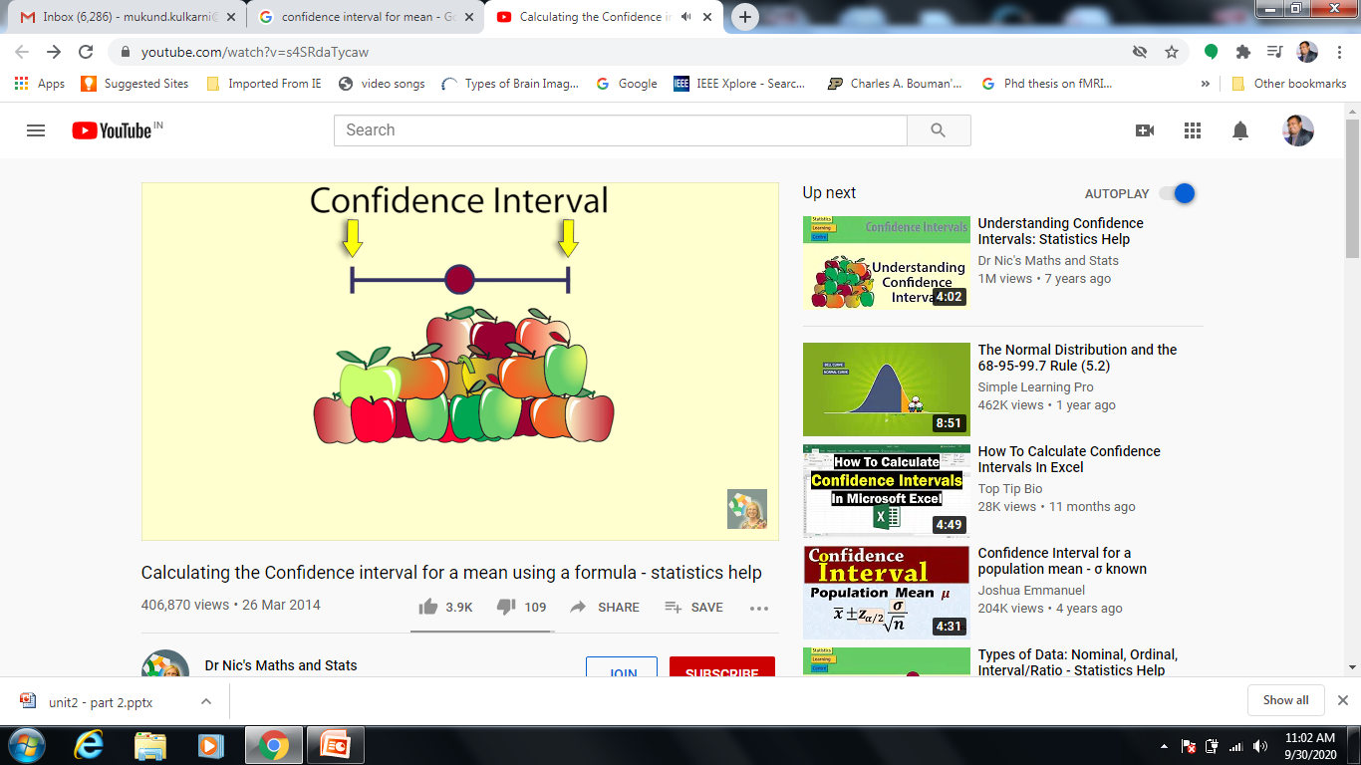
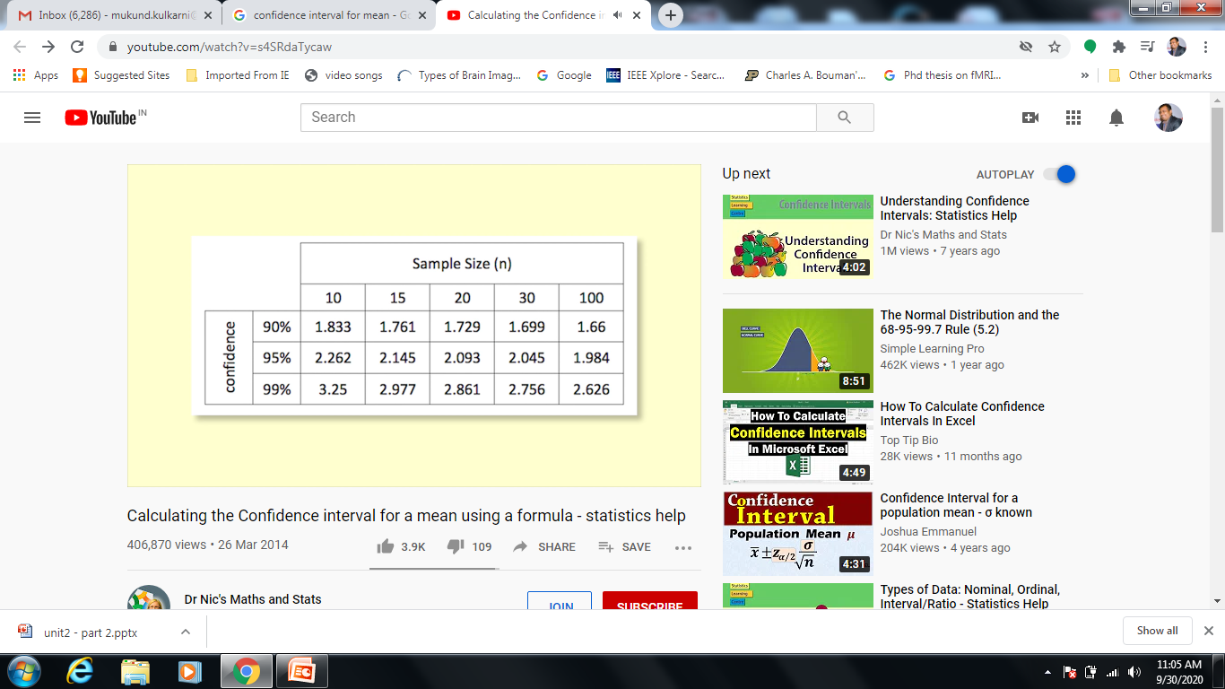
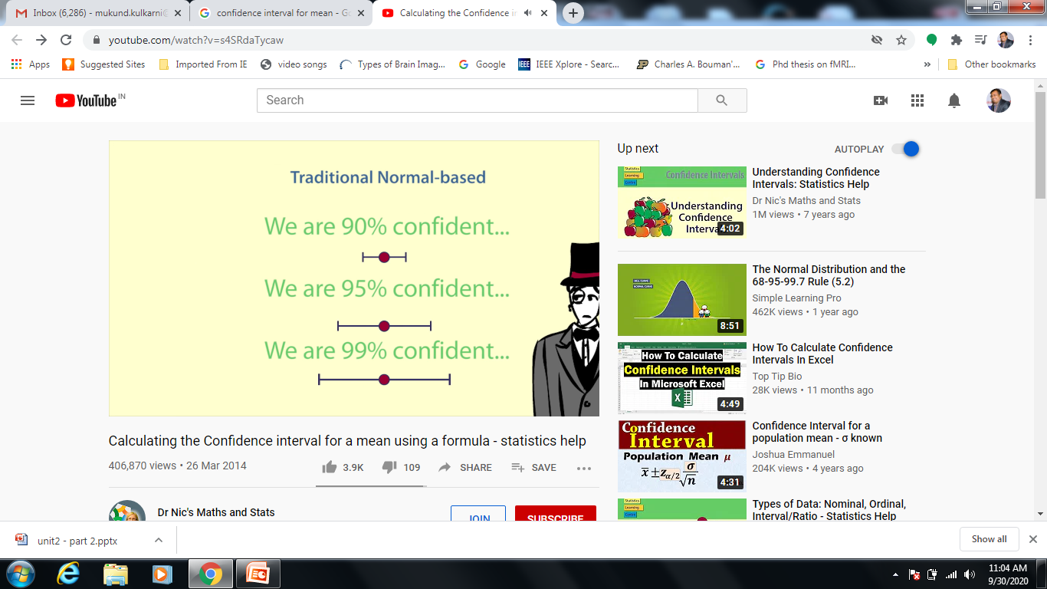
Factors Affecting Width of Confidence Interval

Slide 32
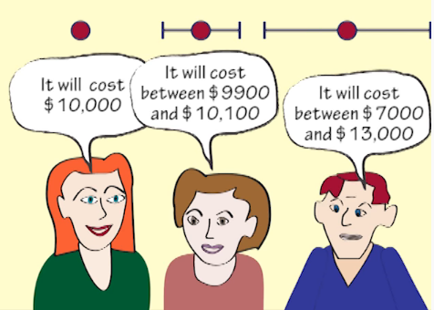
Confidence Interval - Example
Confidence interval communicates:
How accurate our estimate is likely to be!

Slide 33
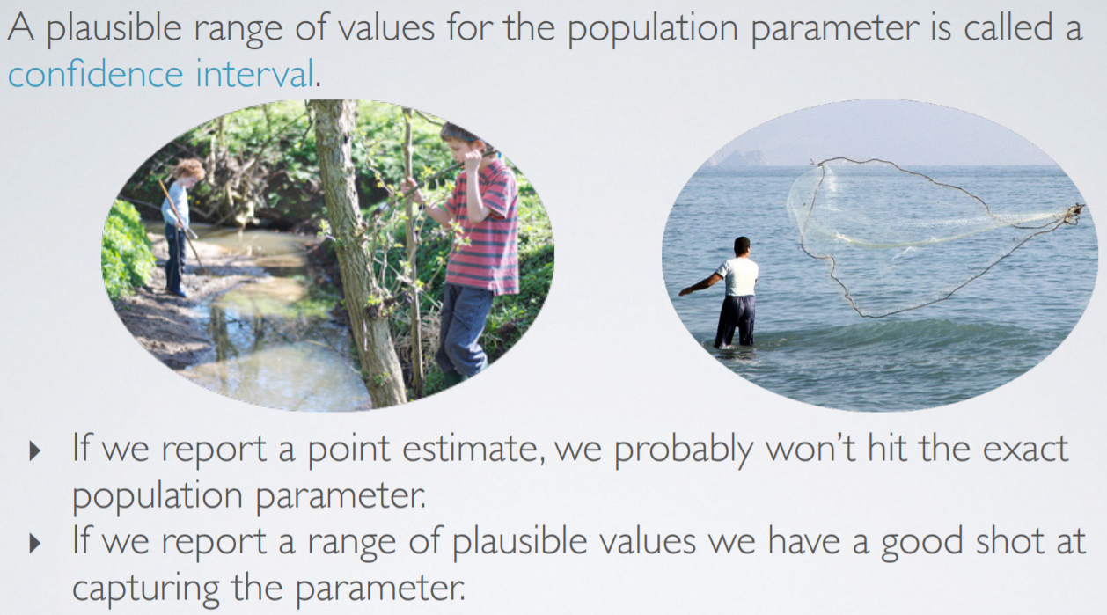
Confidence Interval - Example

Slide 34

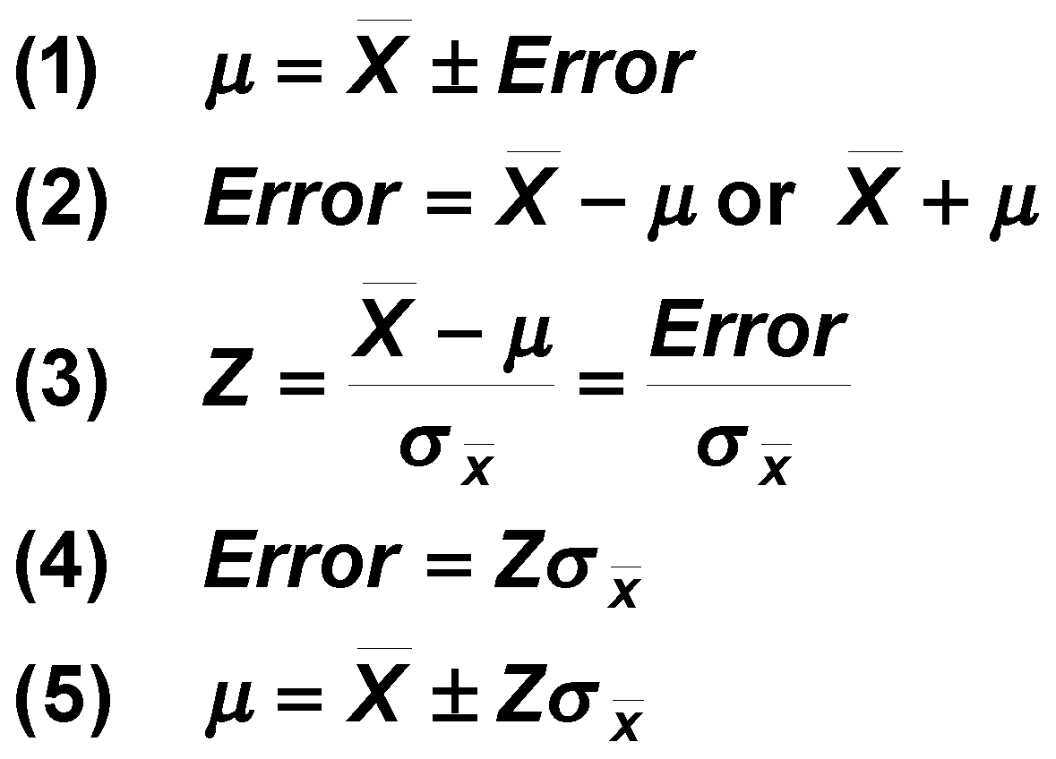
Confidence Limits for Population Mean
Parameter = Statistic ± Error
© 1984-1994 T/Maker Co.
Notes:
27
Z score helps to compare between two different samples

Slide 35
Many Samples Have Same Interval
Notes:
28

Slide 36
Many Samples Have Same Interval
σ
_
x
X
μ
Notes:
29

Slide 37
Confidence Interval
X = μ ± Zσ_{x}
σ
_
x
X
μ
Notes:
30

Slide 38
Confidence Interval
X = μ ± Zσ_{x}
σ
_
x
X
μ
μ-1σ_{x}
μ+1σ_{x}
68%
Samples
Notes:
31

Slide 39
Confidence Interval
X = μ ± Zσ_{x}
σ
_
x
X
μ
μ-1σ_{x}
μ+1σ_{x}
μ-2σ_{x}
μ+2σ_{x}
68%
Samples
95% Samples
Notes:
31

Slide 40
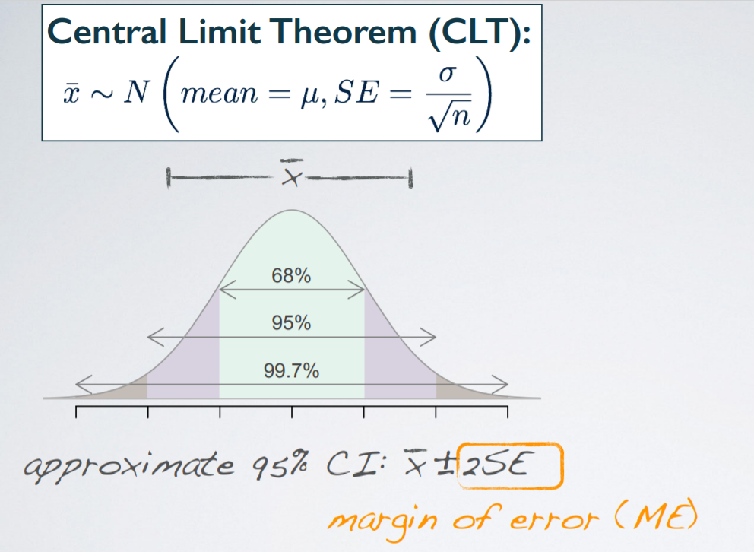
Many Samples Have Same Interval
Distribution of sample means approximates a normal distribution as the sample size gets larger, regardless of the population's distribution.

Slide 41
Central Limit Theorem
Sample sizes equal to or greater than 30 are often considered sufficient for the CLT to hold.
A key aspect of CLT is that the average of the sample means and standard deviations will equal the population mean and standard deviation.
A sufficiently large sample size can predict the characteristics of a population more accurately.
Notes:
CLT is useful in finance when analyzing a large collection of securities to estimate portfolio distributions and traits for returns, risk, and correlation.

Slide 42
Central Limit Theorem
Sampling is successive. This means some sample units are common with sample units selected on previous occasions.
Sampling is random. All samples must be selected at random so that they have the same statistical possibility of being selected.
Samples should be independent. The selections or results from one sample should have no bearing on future samples or other sample results.
Samples should be limited. It's often cited that a sample should be no more than 10% of a population if sampling is done without replacement. In general, larger population sizes warrant the use of larger sample sizes.
Sample size is increasing. The central limit theorem is relevant as more samples are selected.

Slide 43
Confidence Interval
X = μ ± Zσ_{x}
σ
_
x
X
μ
μ+1σ_{x}
μ-3σ_{x}
μ-1σ_{x}
μ+3σ_{x}
μ-2σ_{x}
μ+2σ_{x}
68%
Samples
95% Samples
99.7% Samples
Notes:
31

Slide 44
Confidence Level
1. Probability that the Unknown Population Parameter Falls Within Interval
2. Denoted (1 - α) %
α Is Probability That Parameter Is Not Within Interval
3. Typical Values Are 99%, 95%, 90%

Slide 45
Confidence Interval
X = μ ± Zσ_{x}
σ
_
x
X
μ
μ+1.65σ_{x}
μ-1.65σ_{x}
90% Samples
Notes:
31

Slide 46
Confidence Interval
X = μ ± Zσ_{x}
σ
_
x
X
μ
μ+1.65σ_{x}
μ-1.65σ_{x}
μ-1.96σ_{x}
μ+1.96σ_{x}
90% Samples
95% Samples
Notes:
32

Slide 47
Confidence Interval
X = μ ± Zσ_{x}
σ
_
x
X
μ
μ+1.65σ_{x} μ+2.58σ_{x}
μ-2.58σ_{x} μ-1.65σ_{x}
μ-1.96σ_{x}
μ+1.96σ_{x}
90% Samples
95% Samples
99% Samples
Notes:
33

Slide 48
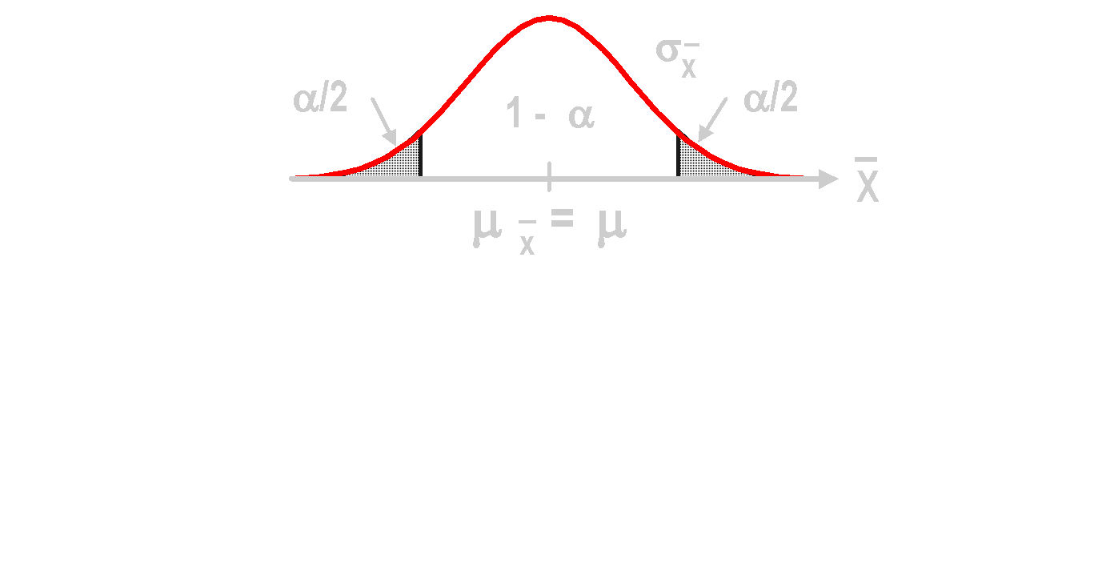
Intervals & Confidence Level
Sampling Distribution of Mean
Intervals extend from X - Zσ_{X} to X + Zσ_{X}
(1 - α) % of intervals contain μ.
α % do not.
Large number of intervals
Notes:
35
Notice that the interval width is determined by 1-α in the sampling distribution.

Slide 49

Factors Affecting Interval Width
1. Data Dispersion
Measured by σ
2. Sample Size
σ_{X} = σ / √n
3. Level of Confidence (1 - α)
Affects Z
Intervals Extend from X - Zσ_{X} toX + Zσ_{X}
—
© 1984-1994 T/Maker Co.
Notes:
Have students explain why each of these occurs.
Level of confidence can be seen in the sampling distribution.

Slide 50
Confidence Interval Estimates
Notes:
37

Slide 51
Confidence Interval Estimates
Confidence
Intervals
Notes:
38

Slide 52
Confidence Interval Estimates
Confidence
Intervals
Mean
Notes:
39

Slide 53
Confidence Interval Estimates
Confidence
Intervals
Mean
Proportion
Notes:
40

Slide 54
Confidence Interval Estimates
Confidence
Intervals
Mean
Proportion
Variance
Notes:
41

Slide 55
Confidence Interval Estimates
Confidence
Intervals
Mean
Proportion
Variance
σ
Known
Notes:
42

Slide 56
Confidence Interval Estimates
Confidence
Intervals
Mean
Proportion
Variance
σ
Known
σ
Unknown
Notes:
43

Slide 57
Confidence Interval Estimate Mean (σ Known)
Notes:
45
9

Slide 58
Confidence Interval Estimates
Confidence
Intervals
Mean
Proportion
Variance
σ
Known
σ
Unknown
Notes:
43

Slide 59
Confidence Interval Mean (σ Known)
1. Assumptions
Population Standard Deviation Is Known
Population Is Normally Distributed
If Not Normal, Can Be Approximated by Normal Distribution (n ≥ 30)

Slide 60
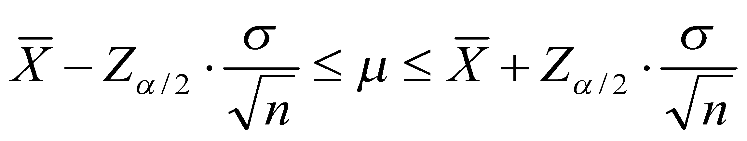
Confidence Interval Mean (σ Known)
1. Assumptions
Population Standard Deviation Is Known
Population Is Normally Distributed
If Not Normal, Can Be Approximated by Normal Distribution (n ≥ 30)
2. Confidence Interval Estimate

Slide 61
Estimation Example Mean (σ Known)
The mean of a random sample of n = 25 isX = 50. Set up a 95% confidence interval estimate for μ if σ = 10.
Notes:
49

Slide 62
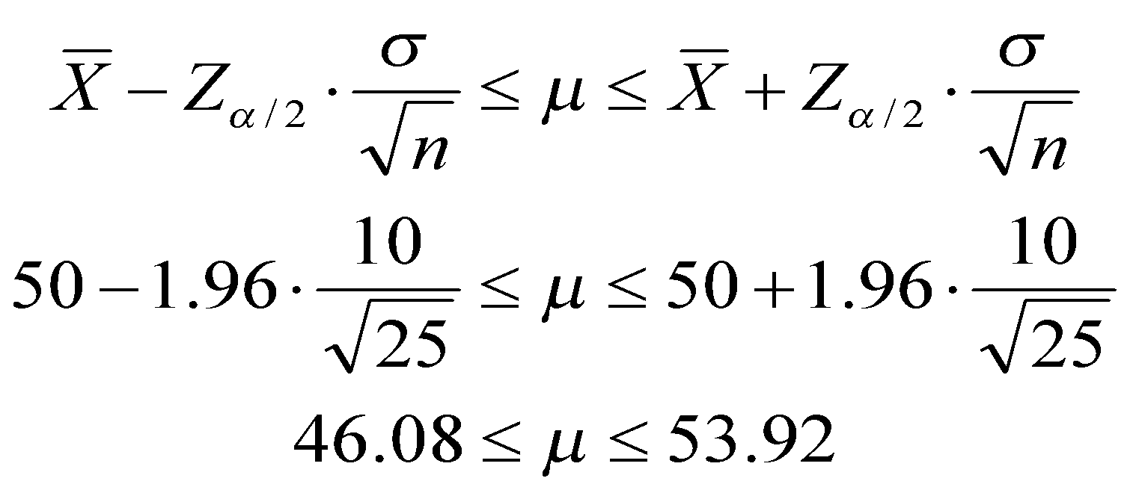
Estimation Example Mean (σ Known)
The mean of a random sample of n = 25 isX = 50. Set up a 95% confidence interval estimate for μ if σ = 10.
Notes:
50

Slide 63
Confidence Interval of a Population Mean
What is the critical value for the 98% Confidence Interval?
Z = 2.05
Z = -1.96
Z = 2.33
Z = -2.33
Z = 1.96
Notes:
Ans. ‘c’

Slide 64
Thinking Challenge
You’re a Q/C inspector for Gallo. The σ for 2-liter bottles is .05 liters. A random sample of 100 bottles showedX = 1.99 liters. What is the 90% confidence interval estimate of the true mean amount in 2-liter bottles?
2 liter
2 liter
© 1984-1994 T/Maker Co.

Slide 65
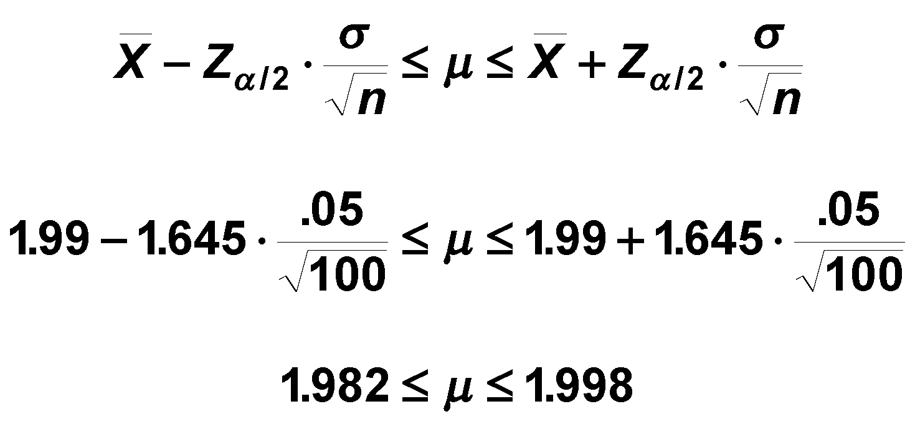
Confidence Interval Solution*
Notes:
52

Slide 66
Confidence Interval Estimate Mean (σ Unknown)
Notes:
53
9

Slide 67
Confidence Interval Estimates
Confidence
Intervals
Mean
Proportion
Variance
σ
Known
σ
Unknown
Notes:
43

Slide 68
Confidence Interval Mean (σ Unknown)
1. Assumptions
Population Standard Deviation Is Unknown
Population Must Be Normally Distributed
2. Use Student’s t Distribution

Slide 69
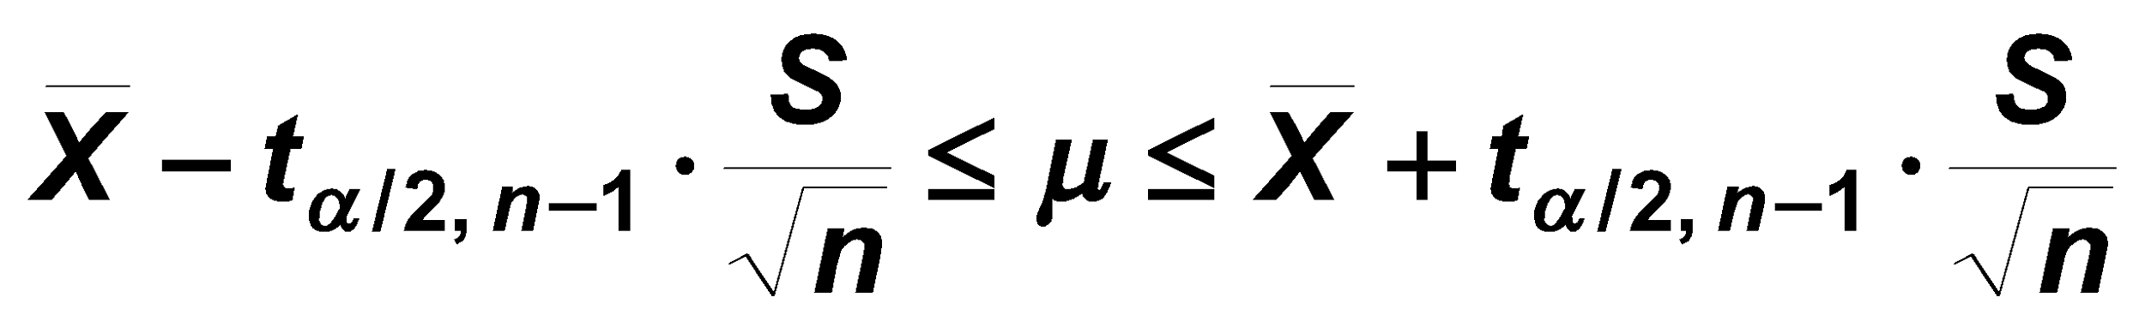
Confidence Interval Mean (σ Unknown)
1. Assumptions
Population Standard Deviation Is Unknown
Population Must Be Normally Distributed
2. Use Student’s t Distribution
3. Confidence Interval Estimate

Slide 70
Student’s t Distribution
Standard Normal
Bell-Shaped
Symmetric
‘Fatter’ Tails
t (df = 13)
t (df = 5)
Z
t
0

Slide 71
Student’s t Table
Notes:
58
Confidence intervals use α/2, so divide α!

Slide 72
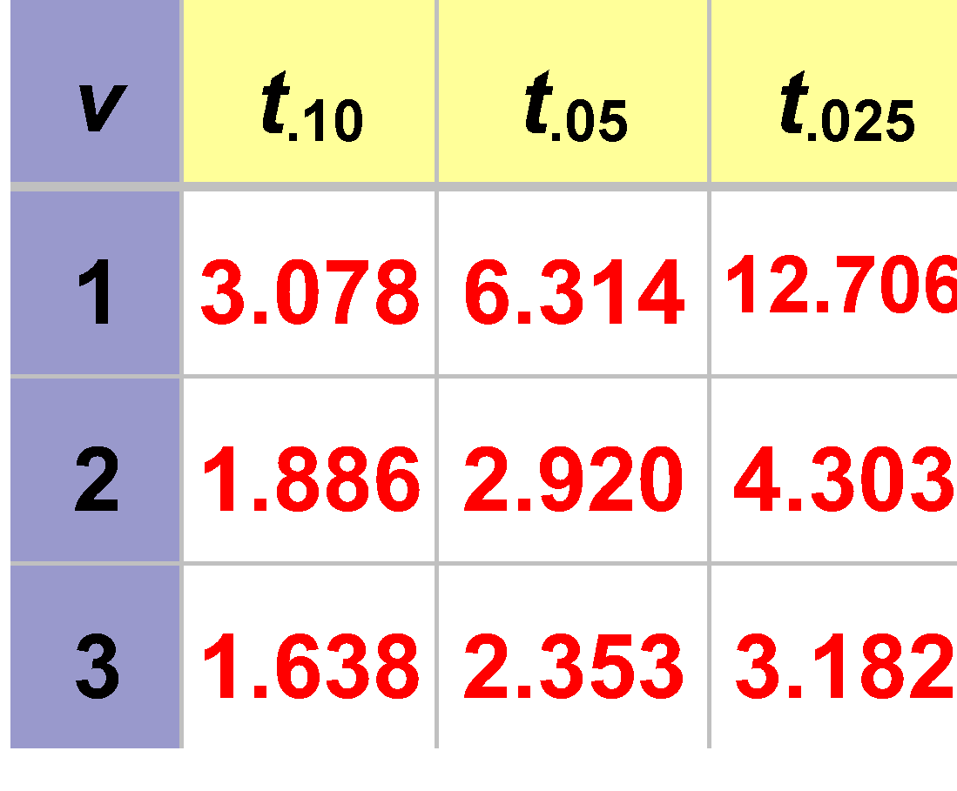
Student’s t Table
Notes:
59
Confidence intervals use α/2, so divide α!

Slide 73
Student’s t Table
t values
Notes:
60
Confidence intervals use α/2, so divide α!

Slide 74
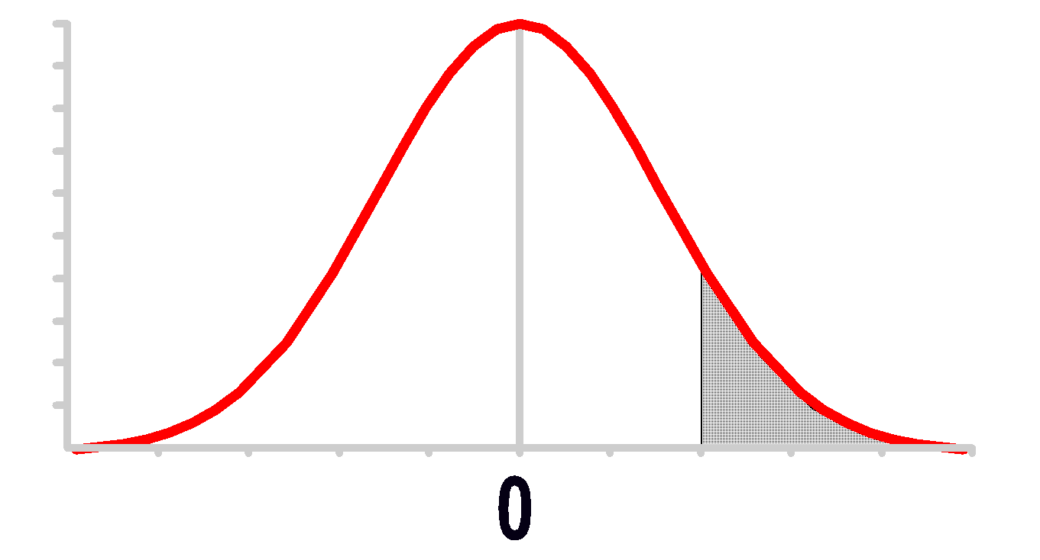
Student’s t Table
α / 2
α / 2
t values
Notes:
61
Confidence intervals use α/2, so divide α!

Slide 75
Student’s t Table
Assume: n = 3 df = n - 1 = 2 α = .10 α/2 =.05
α / 2
α / 2
t values
Notes:
62
Confidence intervals use α/2, so divide α!

Slide 76
Student’s t Table
Assume: n = 3 df = n - 1 = 2 α = .10 α/2 =.05
α / 2
α / 2
t values
Notes:
63
Confidence intervals use α/2, so divide α!

Slide 77
Student’s t Table
Assume: n = 3 df = n - 1 = 2 α = .10 α/2 =.05
α / 2
.05
t values
Notes:
64
Confidence intervals use α/2, so divide α!

Slide 78
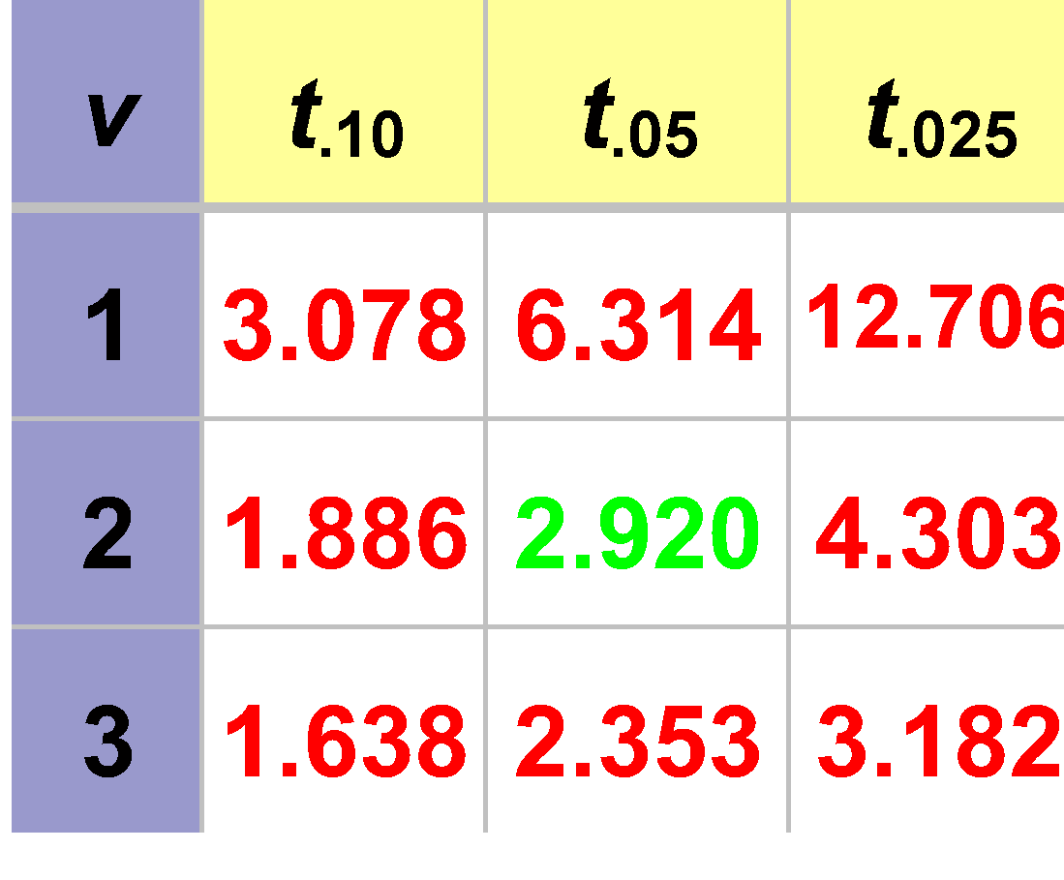
Student’s t Table
Assume: n = 3 df = n - 1 = 2 α = .10 α/2 =.05
α / 2
.05
t values
2.920
Notes:
66
Confidence intervals use α/2, so divide α!

Slide 79
Degrees of Freedom (df)
1. Number of Observations that Are Free to Vary After Sample Statistic Has Been Calculated
2. Example
Sum of 3 Numbers Is 6 X₁ = 1 (or Any Number) X₂ = 2 (or Any Number) X₃ = 3 (Cannot Vary) Sum = 6
degrees of freedom = n -1 = 3 -1 = 2

Slide 80
Estimation Example Mean (σ Unknown)
A random sample of n = 25 hasx = 50 & s = 8. Set up a 95% confidence interval estimate for μ.
Notes:
69

Slide 81
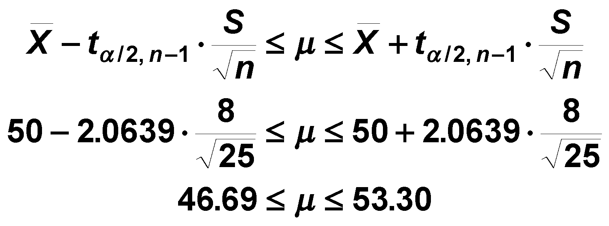
Estimation Example Mean (σ Unknown)
A random sample of n = 25 hasx = 50 & s = 8. Set up a 95% confidence interval estimate for μ.
Notes:
70

Slide 82
Thinking Challenge
You’re a time study analyst in manufacturing. You’ve recorded the following task times (min.): 3.6, 4.2, 4.0, 3.5, 3.8, 3.1.
What is the 90% confidence interval estimate of the population mean task time?
Notes:
Allow students about 20 minutes to solve.

Slide 83
Confidence Interval Solution*
X = 3.7
S = 3.8987
n = 6, df = n - 1 = 6 - 1 = 5
S / √n = 3.8987 / √6 = 1.592
t_{.05,5} = 2.0150
3.7 - (2.015)(1.592) ≤ μ ≤ 3.7 + (2.015)(1.592)
0.492 ≤ μ ≤ 6.908
Notes:
72

Slide 84
Conclusion
1. Stated What Is Estimated
2. Distinguished Point & Interval Estimates
3. Explained Interval Estimates
4. Computed Confidence Interval Estimates for Population Mean & Proportion
5. Computed Sample Size

